Slide 1
Energy and Policy Considerations for Deep Learning in NLP
Emma Strubell Ananya Ganesh Andrew McCallum
University of Massachusetts Amherst
(Accepted to ACL 2019)
Hongru Huang, 2019/6/11
Notes:
Good afternoon everyone. Today I am going to talk about a paper which have caught much attention and aroused heated discussion in AI, especially NLP research community: ”Energy and Policy Considerations for Deep Learning in NLP”. This paper discussed several phenomenon in current neural network training, quantitively calculated the carbon footprint of training and fine-tuning several well-known NLP models, and proposed their suggestions regarding those results. It is simple in terms of its task and methods, but it did a great job in making researchers aware of their environmental effects and responsibilities.

Slide 2
Outline
Current Situations
Carbon Footprint Calculation
Comparisons of Various Models
Conclusions (theirs)
Situation in our lab
Conclusions (ours)
Notes:
We will firstly introduce how they calculate the carbon footprint. Based on the method, they compared various models and come to their conclusion. We also do a rough test for our lab based on the proposed method.

Slide 3
Current Situation: Why NN carbon footprint worth study
NLP tasks: the most computationally-hungry models obtaining the highest scores
Experiments in development and fine-tuning process can multiply these costs by thousands of times.
Requirement of specialized hardware such as GPUs or TPUs
Incurring substantial cost to the environment
Notes:
In this paper the authors first summarize some situations in current NLP research.
First, in NLP tasks where accuracies are competed, the most computationally-hungry models are obtaining the highest scores. Some examples can be BERT proposed by Google, GPT-2 proposed by OpenAI and ELMo by Allen Institute of artificial intelligence.
Second, research and development of new models multiply these costs by thousands of times by requiring retraining to experiment with model architectures and hyperparameters: Training for once is not that costly, but we often do it thousands of times!
What’s more, such intensive computation require specialized hardware such as GPUs or TPUs, therefore is not affordable for everyone.
Finally and also what the paper focus on, is the environmental costs. The energy required to power those hardware for weeks or months at a time can be quite a lot. model training and development likely make up a substantial portion of the greenhouse gas emissions attributed to many NLP researchers

Slide 4


Carbon Footprint Calculation:
To quantify the computational and environmental cost of training deep neural network models:
1. estimate the kilowatts of energy required
2. estimate CO2 emissions from power usage:
Notes:
the authors calculated the carbon footprint of training a neural network in 2 steps:
First they use the first equation(1.里面的公式) to calculate the total average power draw based on average power draws of CPU, GPUs and DRAMs. 1.58 in the equation is a PUE coefficient, which takes power usage effectiveness(e.g. extra use in cooling) into consideration.
The second step is to convert power to estimated CO2 emissions with the second equation.

Slide 5
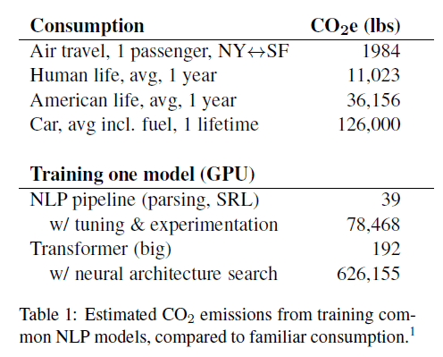
Results: Compare training with life activities
Notes:
Table 1 shows the CO2 emission of some real life activities, and those of common training process in nlp. We can see that even though running a single model doesn’t seem destructive, with tuning and experimentation, training a transformer can cause the same amount of CO2 gases to be released into the air with 5 cars running for a lifetime. This is quite astonishing results.
Table 3 lists CO2 emissions and estimated cost of training the models using previously mentioned methods.

Slide 6
Results: Compare training with life activities
Notes:
Table 1 shows the CO2 emission of some real life activities, and those of common training process in nlp. We can see that even though running a single model doesn’t seem destructive, with tuning and experimentation, training a transformer can cause the same amount of CO2 gases to be released into the air with 5 cars running for a lifetime. This is quite astonishing results.
Table 3 lists CO2 emissions and estimated cost of training the models using previously mentioned methods.

Slide 7
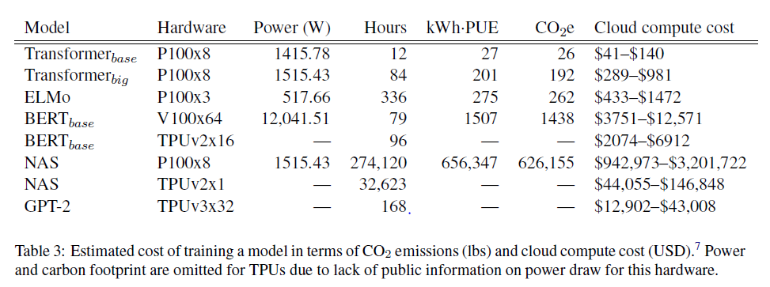
Results: Comparing different models
Notes:
Table 3 lists CO2 emissions and estimated cost of training the models using previously mentioned methods.
We see that models emit substantial carbon emissions; training BERT on GPU is roughly equivalent to a trans-American flight. NAS has been reported to achieve a new state-of-
the-art BLEU score of 29.7 for English to German machine translation, an increase of just 0.1 BLEU at the cost of at least $150k in on-demand compute time and non-trivial carbon emissions. Besides, training on TPUs seems to be more ost-efficient than GPUs for BERT.

Slide 8
Results: Comparing different models
Notes:
Table 3 lists CO2 emissions and estimated cost of training the models using previously mentioned methods.
We see that models emit substantial carbon emissions; training BERT on GPU is roughly equivalent to a trans-American flight. NAS has been reported to achieve a new state-of-
the-art BLEU score of 29.7 for English to German machine translation, an increase of just 0.1 BLEU at the cost of at least $150k in on-demand compute time and non-trivial carbon emissions. Besides, training on TPUs seems to be more ost-efficient than GPUs for BERT.

Slide 9
Results: Comparing different models
Notes:
Table 3 lists CO2 emissions and estimated cost of training the models using previously mentioned methods.
We see that models emit substantial carbon emissions; training BERT on GPU is roughly equivalent to a trans-American flight. NAS has been reported to achieve a new state-of-
the-art BLEU score of 29.7 for English to German machine translation, an increase of just 0.1 BLEU at the cost of at least $150k in on-demand compute time and non-trivial carbon emissions. Besides, training on TPUs seems to be more ost-efficient than GPUs for BERT.

Slide 10
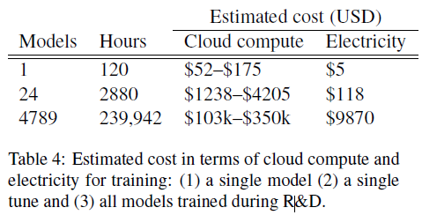
Case Study: Cost of Development
What does it cost(financially) to transfer a model to a new task (tuning the parameters?)
Notes:
Since in recent neural network research, researchers usually run a model not once but multiple times with nuances in structure or differences in parameters, the authors also performed a case study on the cost of fine tuning a model. They take the paper ”Linguistically Informed Self-Attention” as an example, which proposed an nlp pipeline and has been a best paper at EMNLP. The sum GPU time required for the project totaled 9998 days (27 years), and the estimated cost in terms of cloud computer and electricity are shown in the table. From is we can see that tuning and experimentation multiplies the costs, and correspondingly, CO2 emission, by thousands of times.
(表格里R&D的意思是research and development)

Slide 11
Suggestions (theirs)
Time to retrain and sensitivity to hyperparameters should be reported for NLP machine learning models
Academic researchers need equitable access to computational resources
Researchers should prioritize developing efficient models and hardware.
Notes:
Based on those numbers, the authors proposed several suggestions for future NLP study. First is time to retrain and sensitivity to hyperparameters should be reported for NLP models. This means R&D cost will be taken as an important measure of model success when researches are evaluated. I think this can promote the 3rd suggestion: Researchers should prioritize developing efficient models and hardware. An emphasis on being environmental-friendly and effective during paper review process can naturally get people’s attention on those issues. And the second suggestion is to make computing powers more attainable to all researchers who desire access.

Slide 12
Situations in our lab
Based on their calculation methods, I ran some experiments on milkyway and try to find out how much resources we take when we run models in our lab. (hope it’s correct)
pg = 211.268
pc = 23.714664989944698 + 13.923482793866265
pr = 1.9553218577174458 + 1.1857830847159379
g = 1
Pt =0.398t, CO2e = 0.38t
Therefore, if our model run 3 days on milkyway with one GPU, it will release 27.35 lbs CO2 into the air. This approximately equals to an average day of a human life.
If we submit to 2 conferences each year, for each conference we run our model 10 times to find the best parameter sets, then the annual emission will be about 600 lbs, which is close to a round-trip flight between Beijing and Shanghai.
Notes:
By running commands like nvidia-smi --query-gpu=power.draw --format=csv --loop-ms=1000 once a second(which is the method proposed in the paper)
We can find out the energy consuming rate of our servers.
(用上面这个命令每秒运行一次 可以获得运行的即时能量。论文里是每小时平均一下作为最终的结果。我跑这个的时候milkyway上珊珊正在跑实验，就用了她的这个能量消耗。Pc和pr的加号是CPU的两个package. 这些p的单位都是瓦. 如果时间不够的话这里可以多讲一点)
Ppt里下面的结果直接读就可以了
Those numbers are actually not that astonishing, compared with what we saw before with the larger models trained in large companies. So maybe it’s better for the environment if researchers to stay poor and have fewer machines in their computer labs(大雾). But still, it’s good to keep in mind that every time we run a model, something is taken from our earth.

Slide 13
Conclusion (ours)
Stay aware of what we are doing to the earth!
Notes:
This paper doesn’t tackle any technical challenge. But it reminds researchers of what to keep in mind when doing their work. I think we should always ask ourselves whether our work is making contributions to humankind, or are we pointlessly waste resources by doing meaningless work. To keep science and technology developing while preserving our environment to the greatest degree, we should think of best optimizations and carefully check our code every time before we hit the “run” button.

